Slide 1
Chapter 1: Architecture, Containers, APIs introduction
Jakarta EE
https://jakarta.ee/specifications/platform/9/jakarta-platform-spec-9.html
Notes:
https://jakarta.ee/specifications/platform/9/apidocs/

Slide 2
Content
1.1. Jakarta EE Architecture
1.2. Jakarta EE Containers
1.3. Jakarta EE APIs

Slide 3
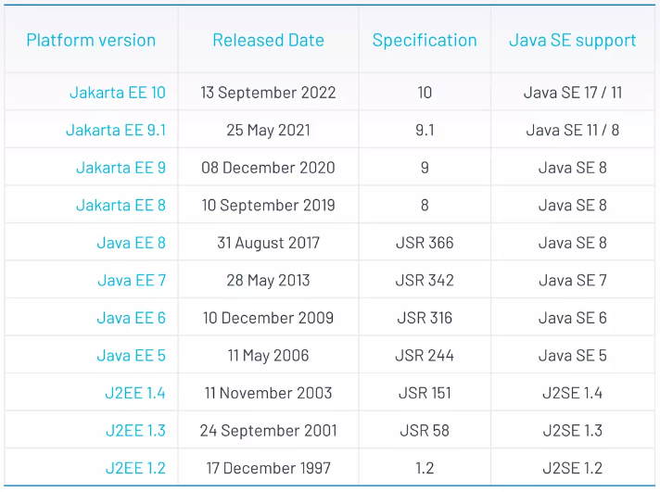
History

Slide 4
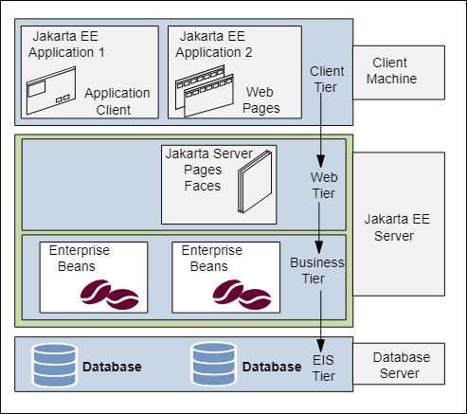
Jakarta EE Architecture
Distributed Multitiered Applications
The Jakarta EE application parts:
Client-tier components run on the client machine.
Web-tier components run on the Jakarta EE server.
Business-tier components run on the Jakarta EE server.
Enterprise information system (EIS)-tier software runs on the EIS server.
Although a Jakarta EE application can consist of all tiers , Jakarta EE multitiered applications are generally considered to be three-tiered applications because they are distributed over three locations: client machines, the Jakarta EE server machine, and the database or legacy machines at the back end.
Figure 1-1 Multitiered Applications
Notes:
https://jakarta.ee/specifications/platform/9/jakarta-platform-spec-9.html

Slide 5
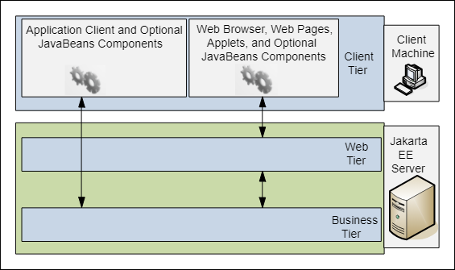
Jakarta EE Architecture
Jakarta EE Server Communications
The various elements that can make up the client tier.
The client communicates with the business tier running on the Jakarta EE server either directly or, as in the case of a client running in a browser, by going through web pages or servlets running in the web tier.
Figure 1-2 Server Communication

Slide 6
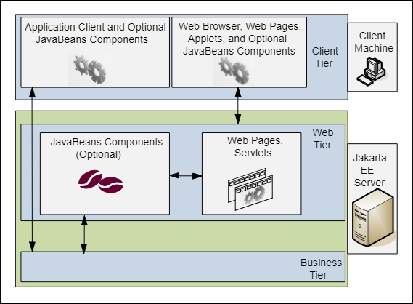
Jakarta EE Architecture
Web Components
Figure 1-3 Web Tier and Jakarta EE Applications

Slide 7
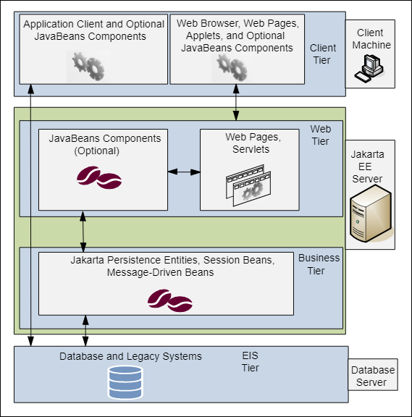
Jakarta EE Architecture
Business Components
Figure 1-4 Business and EIS Tiers
Notes:
Enterprise Information System Tier
The enterprise information system tier handles EIS software and includes enterprise infrastructure systems, such as enterprise resource planning (ERP), mainframe transaction processing, database systems, and other legacy information systems. For example, Jakarta EE application components might need access to enterprise information systems for database connectivity.

Slide 8
Jakarta EE Containers
Container Services
Containers are the interface between a component and the low-level, platform-specific functionality that supports the component. Before it can be executed, a web, enterprise bean, or application client component must be assembled into a Jakarta EE module and deployed into its container.
The assembly process involves specifying container settings for each component in the Jakarta EE application and for the Jakarta EE application itself. Container settings customize the underlying support provided by the Jakarta EE server, including such services as security, transaction management, Java Naming and Directory Interface (JNDI) API lookups, and remote connectivity. Here are some of the highlights.
The Jakarta EE security model lets you configure a web component or enterprise bean so that system resources are accessed only by authorized users.
The Jakarta EE transaction model lets you specify relationships among methods that make up a single transaction so that all methods in one transaction are treated as a single unit.
JNDI lookup services provide a unified interface to multiple naming and directory services in the enterprise so that application components can access these services.
The Jakarta EE remote connectivity model manages low-level communications between clients and enterprise beans. After an enterprise bean is created, a client invokes methods on it as if it were in the same virtual machine.
Notes:
https://jakarta.ee/specifications/platform/10/jakarta-platform-spec-10.0
https://eclipse-ee4j.github.io/jakartaee-firstcup/jakarta-ee002.html

Slide 9
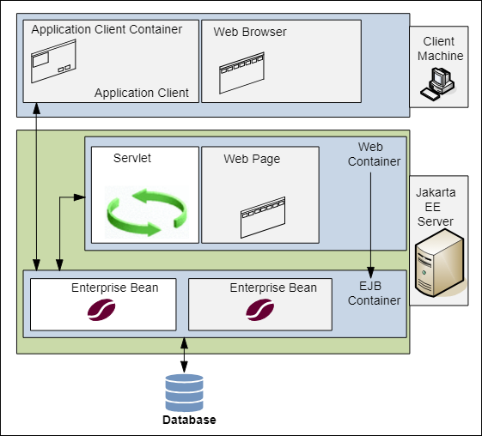
Jakarta EE Containers
Container Types
Figure 1-5 Jakarta EE Server and Containers

Slide 10
Jakarta EE Containers
Container Types
The server and containers are as follows:
Jakarta EE server: The runtime portion of a Jakarta EE product. A Jakarta EE server provides enterprise and web containers.
Jakarta Enterprise Bean container: Manages the execution of enterprise beans for Jakarta EE applications. Jakarta Enterprise Beans and their container run on the Jakarta EE server.
Web container: Manages the execution of web pages, servlets, and some enterprise bean components for Jakarta EE applications. Web components and their container run on the Jakarta EE server.
Application client container: Manages the execution of application client components. Application clients and their container run on the client.
Applet container: Manages the execution of applets. Consists of a web browser and a Java Plug-in running on the client together.

Slide 11
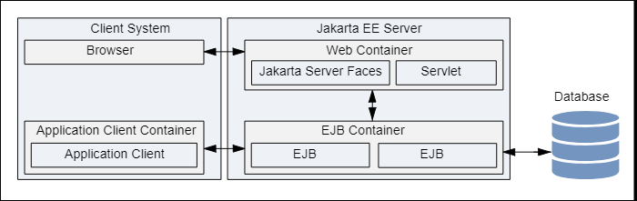
Jakarta EE Containers
The relationships among the Jakarta EE containers
Figure 1-6 The Jakarta EE containers

Slide 12
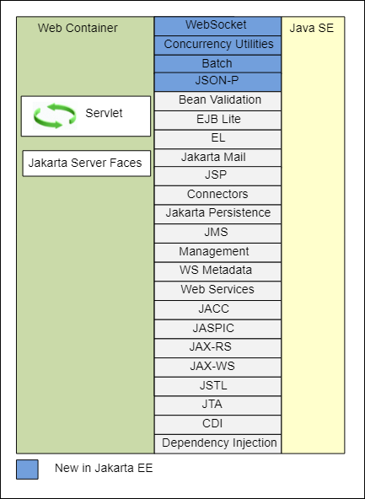
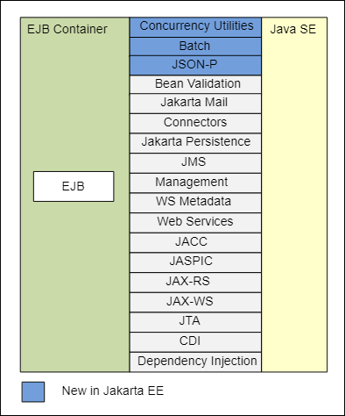
Jakarta EE APIs
Figure 1-8 Jakarta EE APIs in the enterprise bean Container
Figure 1-7 Jakarta EE APIs in the Web Container

Slide 13
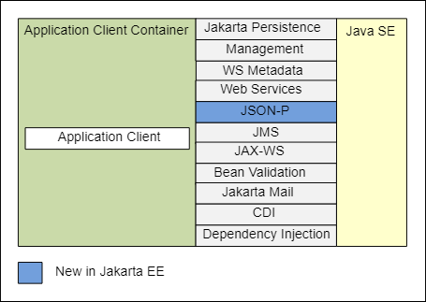
Jakarta EE APIs
Figure 1-9 Jakarta EE APIs in the Application Client Container
Figure 1-8 Jakarta EE APIs in the enterprise bean Container

Slide 14
Jakarta Enterprise Beans Technologies
Jakarta Enterprise Beans Technologies
Jakarta Servlet Technology | Jakarta Authorization
Jakarta Faces Technology | Jakarta Authentication
Jakarta Server Pages Technology | Jakarta Security
Jakarta Standard Tag Library | Jakarta WebSocket
Jakarta Persistence | Jakarta JSON Processing
Jakarta Transactions | Jakarta JSON Binding
Jakarta RESTful Web Services | Jakarta Concurrency
Jakarta Managed Beans | Jakarta Batch
Jakarta Contexts and Dependency Injection | Jakarta Activation
Jakarta Dependency Injection | Jakarta XML Binding
Jakarta Bean Validation | Jakarta XML Web Services
Jakarta Messaging | Jakarta SOAP with Attachments
Jakarta Connectors | Jakarta Annotations
Jakarta Mail
Read more: https://eclipse-ee4j.github.io/jakartaee-tutorial/

Slide 15
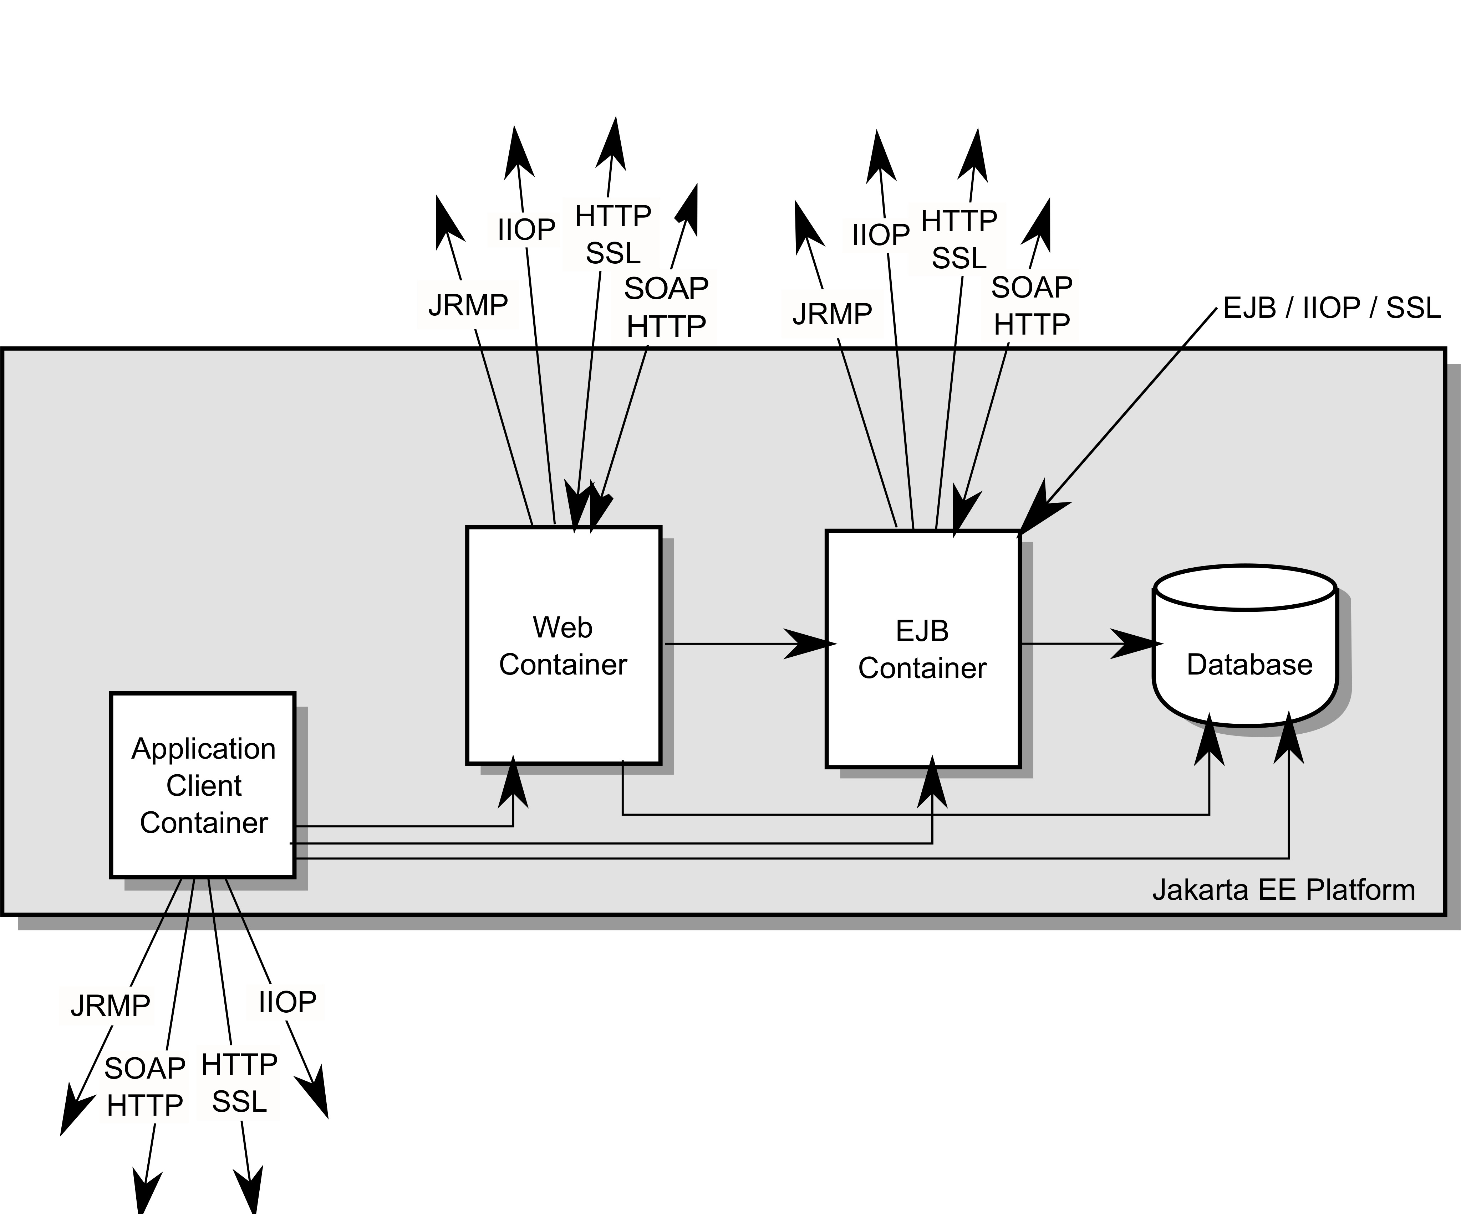
Jakarta EE API Interoperability
Figure 2. Jakarta EE Interoperability

Slide 16
Architecture
Fig1. Jakarta EE Architecture Diagram
https://jakarta.ee/specifications/platform/10/jakarta-platform-spec-10.0

